Slide 1
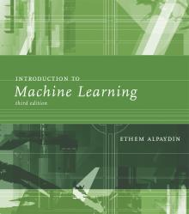
INTRODUCTION TO Machine Learning 3rd Edition
Lecture Slides for
ETHEM ALPAYDIN
© The MIT Press, 2014
alpaydin@boun.edu.tr
http://www.cmpe.boun.edu.tr/~ethem/i2ml3e

Slide 2
CHAPTER 16: Bayesian Estimation

Slide 3
Rationale
Parameters θ not constant, but random variables with a prior, p(θ)
Bayes’ Rule:

Slide 4
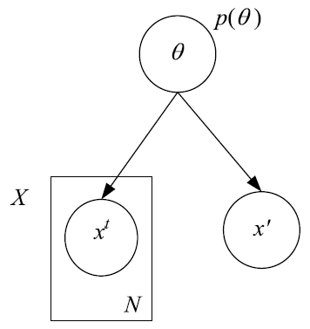



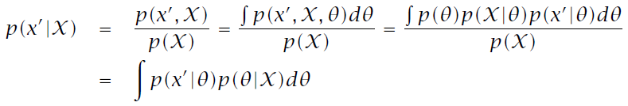
Generative Model

Slide 5

Bayesian Approach
Prior p(θ) allows us to concentrate on region where θ is likely to lie, ignoring regions where it’s unlikely
Instead of a single estimate with a single θ, we generate several estimates using several θ and average, weighted by how their probabilities
Even if prior p(θ) is uninformative, (2) still helps.
MAP estimator does not make use of (2):

Slide 6


Bayesian Approach
In certain cases, it is easy to integrate
Conjugate prior: Posterior has the same density as prior
Sampling (Markov Chain Monte Carlo): Sample from the posterior and average
Approximation: Approximate the posterior with a model easier to integrate
Laplace approximation: Use a Gaussian
Variational approximation: Split the multivariate density into a set of simpler densities using independencies

Slide 7
Estimating the Parameters of a Distribution: Discrete case
x^{t}_{i}=1 if in instance t is in state i, probability of state i is q_{i}
Dirichlet prior, α_{i} are hyperparameters
Sample likelihood
Posterior
Dirichlet is a conjugate prior
With K=2, Dirichlet reduced to Beta

Slide 8
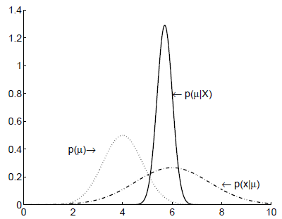
Estimating the Parameters of a Distribution: Continuous case
p(x^{t})~N(μ,σ²)
Gaussian prior for μ, p(μ)~ N(μ₀, σ₀²)
Posterior is also Gaussian p(μ|X)~ N(μ_{N}, σ_{N}²) where

Slide 9

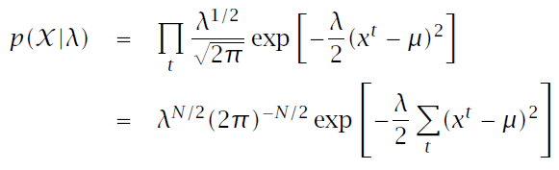

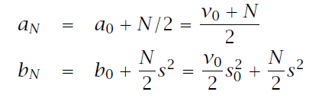
Gaussian: Prior on Variance
Let’s define a prior (gamma) on precision λ=1/σ²

Slide 10

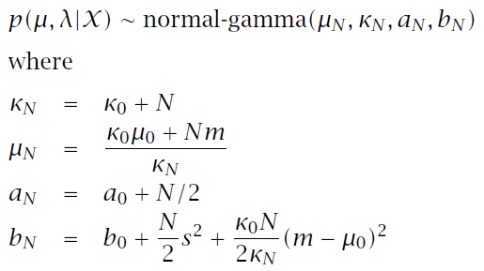
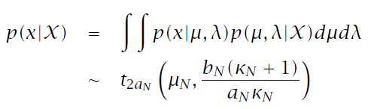
Joint Prior and Making a Prediction

Slide 11




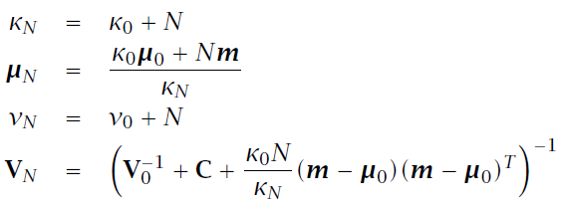
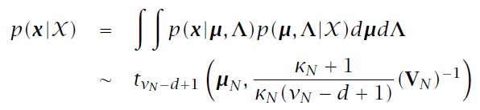
Multivariate Gaussian

Slide 12
Estimating the Parameters of a Function: Regression
r=w^{T}x+ ε, p(ε)~N(0,1/β), and p(r^{t}|x^{t},w, β)~N(w^{T}x^{t}, 1/β)
Log likelihood
ML solution
Gaussian conjugate prior: p(w)~N(0,1/α)
Posterior: p(w|X)~N(μ_{N},Σ_{N}) where
Aka ridge regression/parameter shrinkage/
L2 regularization/weight decay

Slide 13
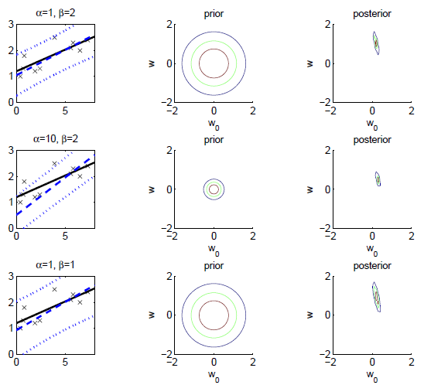

Slide 14


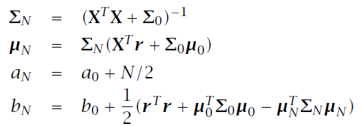
Prior on Noise Variance
Markov Chain Monte Carlo (MCMC) sampling

Slide 15
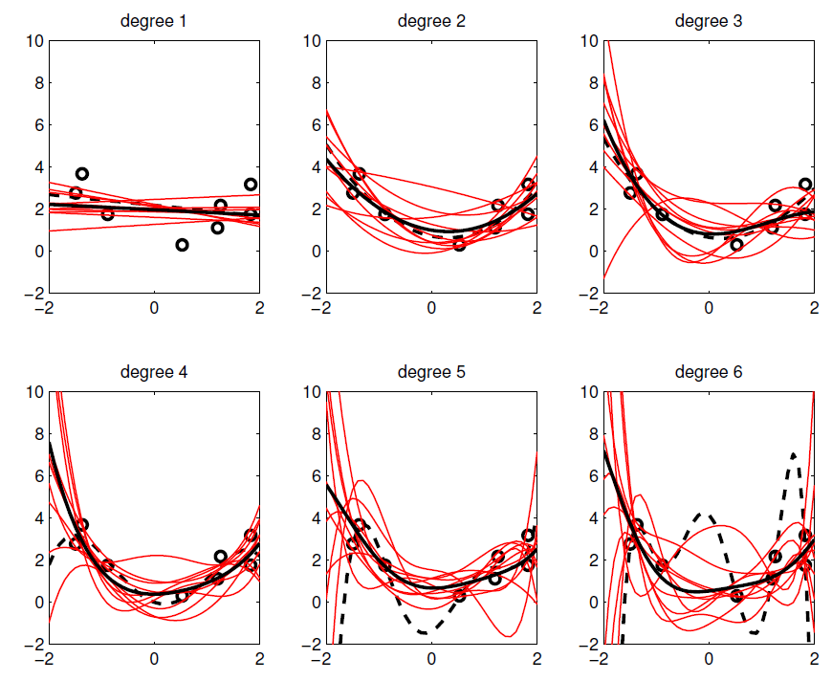

Slide 16
Basis/Kernel Functions
For new x’, the estimate r’ is calculated as
Linear kernel
For any other φ(x), we can write K(x’,x)=φ(x’)^{T}φ(x)
Dual representation
16
16

Slide 17
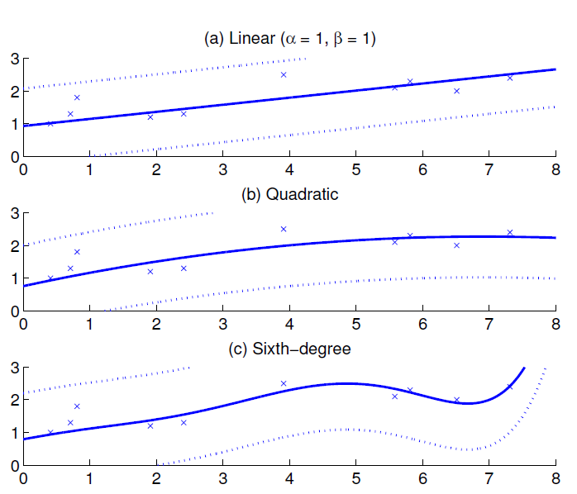
Kernel Functions

Slide 18



What’s in a Prior?
Defining a prior is subjective
Uninformative prior if no prior preference
How high to go?
Empirical Bayes: Use one good α*

Slide 19





Bayesian Model Comparison
Marginal likelihood of a model:
Posterior probability of model given data:
Bayes’ factor:
Approximations:
BIC:
AIC:

Slide 20
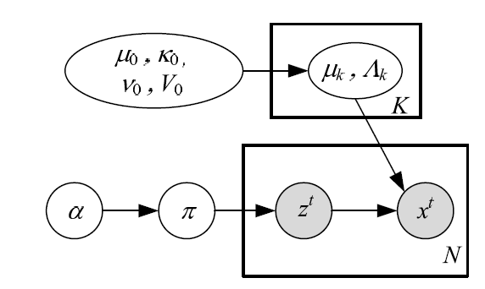

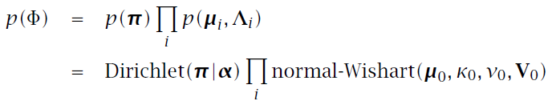
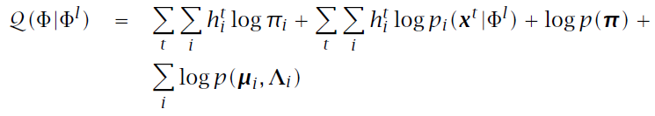
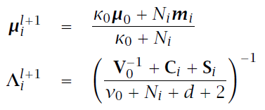

Mixture Model

Slide 21
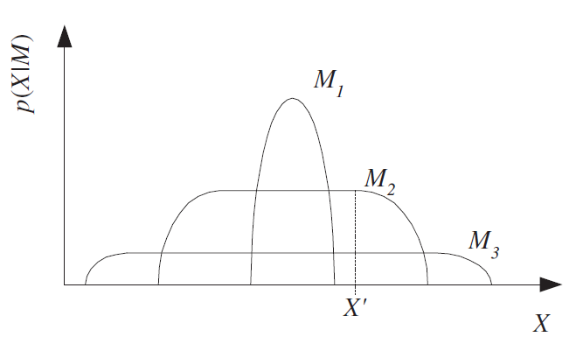
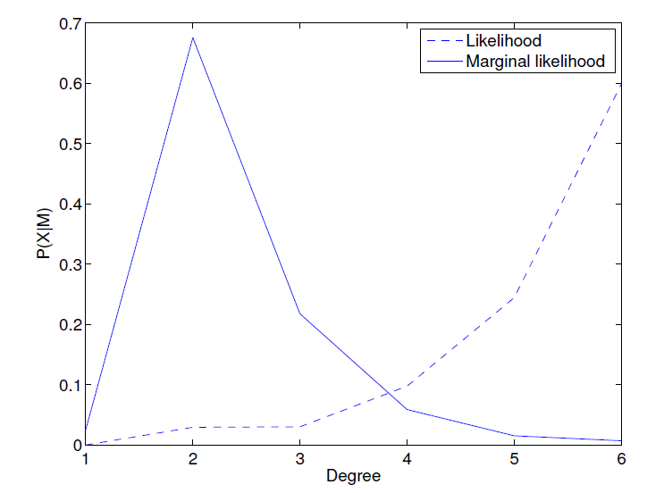
Models in increasing complexity.
A complex model can fit more datasets but is spread thin,
a simple model can fit few datasets but has higher marginal
likelihood where it does
(MacKay 2003)

Slide 22
Nonparametric Bayes
Model complexity can increase with more data (in practice up to N, potentially to infinity)
Similar to k-NN and Parzen windows we saw before where training set is the parameters

Slide 23
Gaussian Processes
Nonparametric model for supervised learning
Assume Gaussian prior p(w)~N(0,1/α)
y=Xw, where E[y]=0 and Cov(y)=K with K_{ij}= (x^{i})^{T}x^{i}
K is the covariance function, here linear
With basis function φ(x), K_{ij}= (φ(x^{i}))^{T}φ(x^{i})
r~N_{N}(0,C_{N}) where C_{N}= (1/β)I+K
With new x’ added as x_{N+1}, r_{N+1}~N_{N+1}(0,C_{N+1})
where k = [K(x’,x^{t})_{t}]^{T} and c=K(x’,x’)+1/β.
p(r’|x’,X,r)~N(k^{T}C_{N-1}r,c-k^{T}C_{N-1}k)
23
23
23

Slide 24
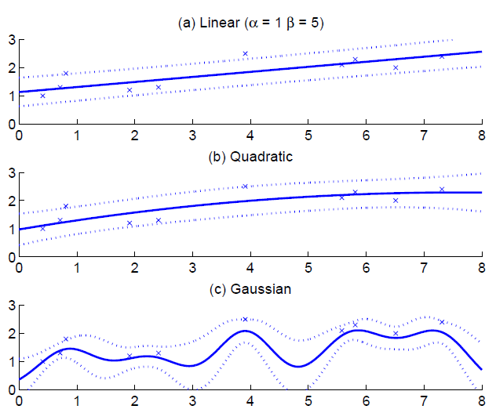

Slide 25
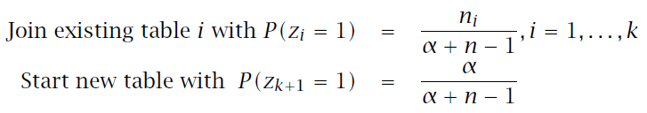
Dirichlet Processes
Nonparametric Bayesian approach for clustering
Chinese restaurant process
Customers arrive and either join one of the existing tables or start a new one, based on the table
occupancies:

Slide 26
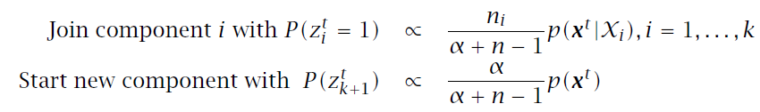
Nonparametric Gaussian Mixture
Tables are Gaussian components and decisions based both on prior and also on input x:

Slide 27

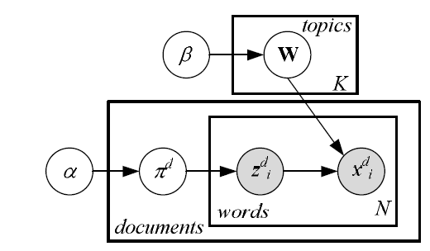



Latent Dirichlet Allocation
Bayesian feature extraction

Slide 28



Beta Processes
Nonparametric Bayesian approach for feature extraction
Matrix factorization:
Nonparametric version: Allow j to increase with more data probabilistically
Indian buffet process: Customer can take one of the existing dishes with prob μ_{j} or add a new dish to the buffet

